Slide 1

Johanna Blom, Professor of Pediatric Neuroscience and Psychobiology, UNIMORE
&
Daniela Quaggia, Senior Project Manager
Active Citizenship Network

Slide 2


Slide 3
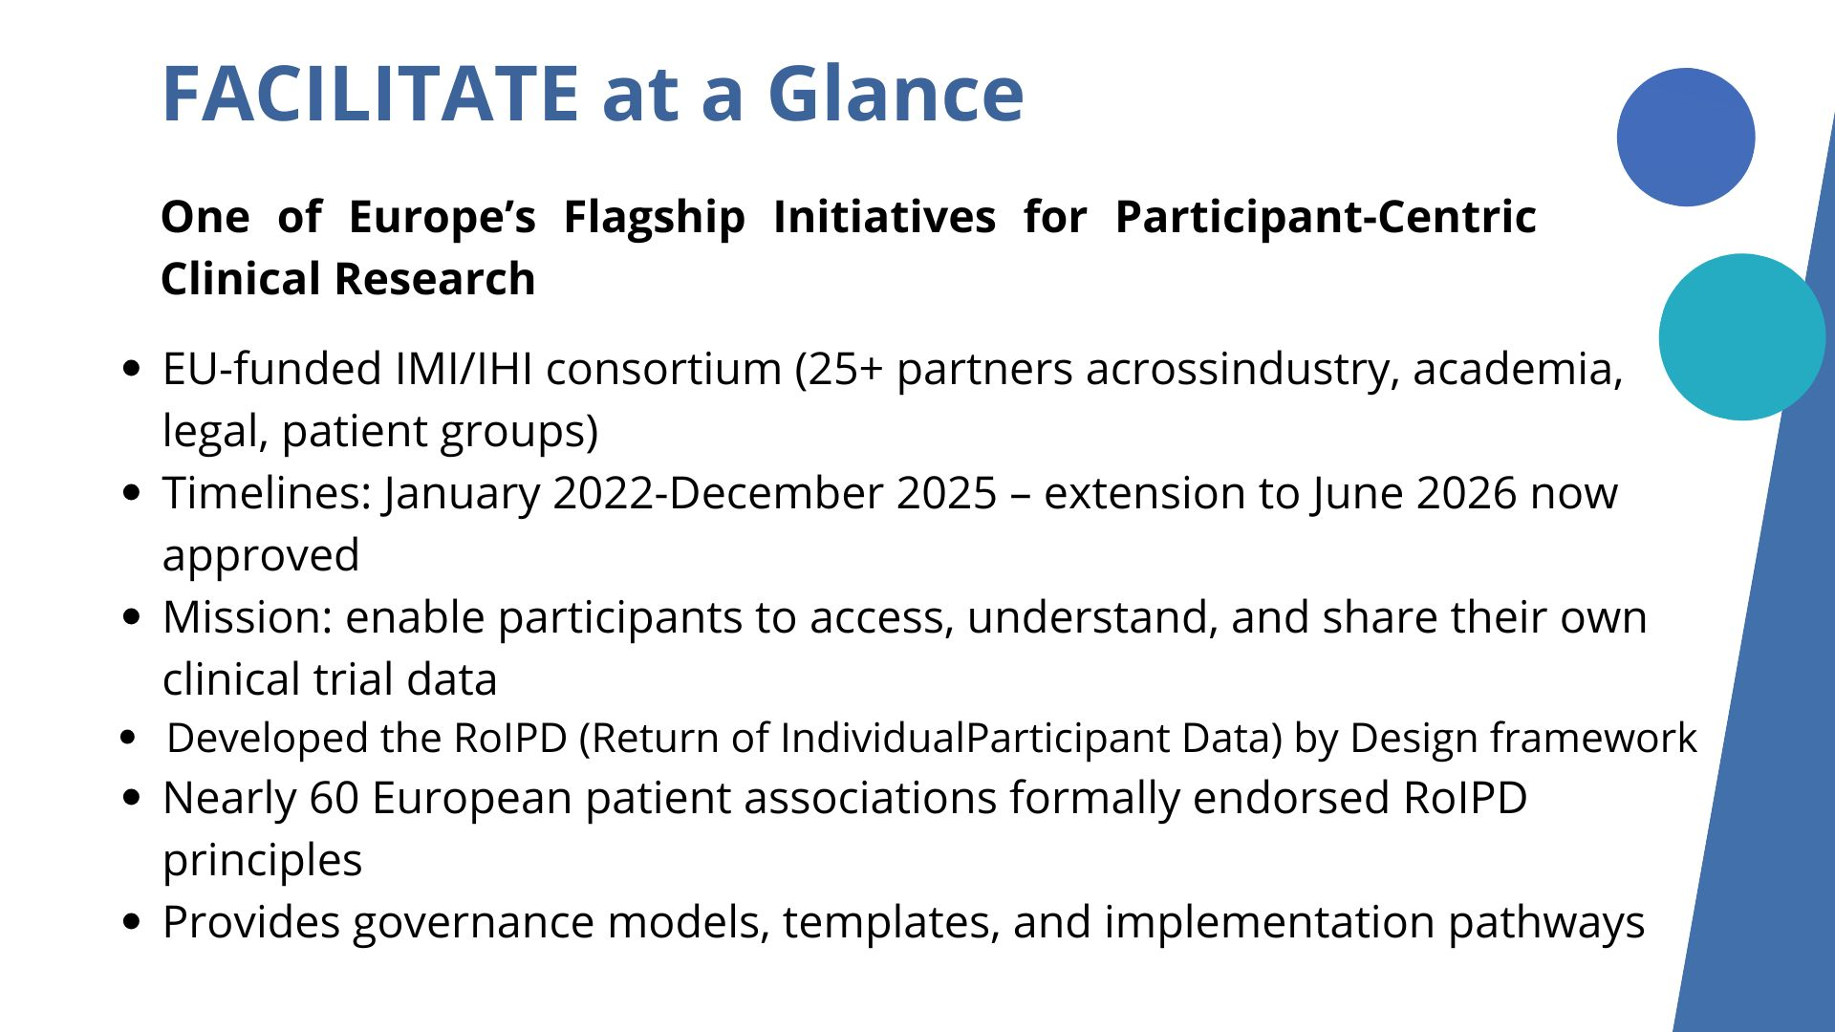




FACILITATE at a Glance
One of Europe’s Flagship Initiatives for Participant-Centric Clinical Research
EU-funded IMI/IHI consortium (25+ partners across industry, academia, legal, patient groups)
Timelines: January 2022-December 2025 – extension to June 2026 now approved
Mission: enable participants to access, understand, and share their own clinical trial data
Developed the RoIPD (Return of Individual Participant Data) by Design framework
Nearly 60 European patient associations formally endorsed RoIPD principles
Provides governance models, templates, and implementation pathways
RETURN individual
Clinical Trial data
to participant
This project has received funding from the Innovative Medicines Initiative 2 Joint Undertaking (JU) under grant agreement No 101034366. The JU receives support from the European Union’s Horizon 2020 research and innovation program and EFPIA.
Notes:
FACILITATE is the only Europe-wide initiative that has solved the practical ‘how’ of returning participant data safely and at scale. It brings together EFPIA companies, patient associations, legal experts, and clinical operations leaders. Importantly, the momentum is strong: almost 60 patient associations have endorsed the RoIPD principles.
The project delivers not just recommendations, but a complete, actionable framework—SOPs, governance, templates, and decision models—that industry can adopt immediately.

Slide 4

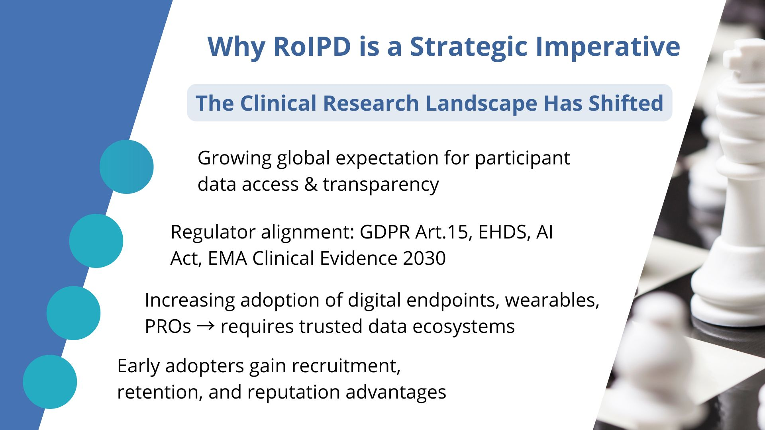
Why RoIPD is a Strategic Imperative
The Clinical Research Landscape Has Shifted
Growing global expectation for participant data access & transparency
Regulator alignment: GDPR Art.15, EHDS, AI Act, EMA Clinical Evidence 2030
Increasing adoption of digital endpoints, wearables, PROs → requires trusted data ecosystems
Early adopters gain recruitment, retention, and reputation advantages
RETURN individual
Clinical Trial data
to participant
This project has received funding from the Innovative Medicines Initiative 2 Joint Undertaking (JU) under grant agreement No 101034366. The JU receives support from the European Union’s Horizon 2020 research and innovation program and EFPIA.
Notes:
“RoIPD is no longer a ‘nice-to-have’—it is becoming a standard expectation. Regulators are converging on transparency and access, while participants increasingly view data return as a sign of respect and trust.
For SANOFI, adopting RoIPD reduces compliance risk, but more importantly, it positions the company as a leader in ethical, participant-centric clinical trials.”

Slide 5

Notes:
Since the beginning, our discussions in FACILTIATE focused on the need to develop participant centric approach to the return of individual participant data. So what do we mean by participant centric?
Participants are viewed as active and equal partners in the research process. They are not passive subjects.
It is an approach that emphasises transparency and communication in developing and operationalisation return of individual participant data
It is an approach that enhances research by aligning with participants’ needs, expectations, and insights.
It reflects a shift from a paternalistic model to shared decision-making and collaboration. Participants’ perspectives are incorporated throughout trial planning and conduct through shared decision making and collaboration
By this we mean taking an intentional approach to RoIPD by designing the processes and planning for its operationalisation at the outset of the clinical trial. This approach will help ensure that mechanisms for RoIPD are embedded into the trial’s design, execution, and post-trial phases rather than being treated as an afterthought.
By embedding RoIPD into trial design planning, RoIPD processes may foster participant engagement and improve trustworthiness.
Why is this key to the FACILITATE approach
Return of individual participant data, like clinical trials, can occur in diverse contexts. As such, at this juncture, a one-size-fits-all approach to RoIPD is impractical and undesirable.
It is for this reason that FACILITATE has focused on ethical guidance that can support the operationalization of RoIPD by design in a flexible and adaptive manner.
By taking a flexible approach it is expected that this will encourage RoIPD by design that is inclusive, scalable, and capable of being effectively implemented across a wide range of trial settings, while adhering to FACILITATE’s principles.

Slide 6
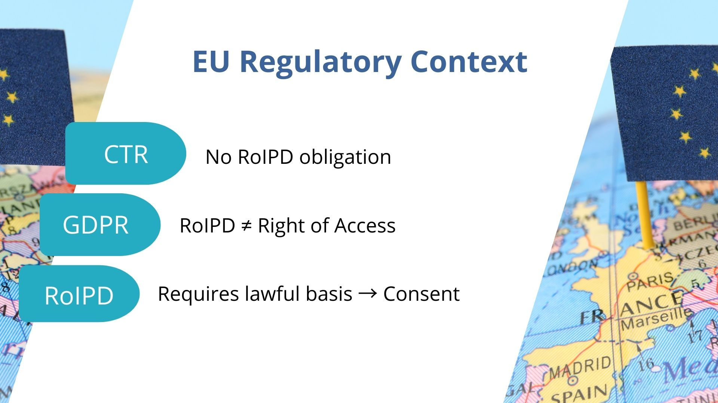
Notes:
Havng examined the pertinent law in this area, it is clear that there is currently no legal mandate for RoIPD at this time. We can perhaps take this up in the panel discussion, but we would not call for a legal mandate at this time.
Turning to the GDPR, questions arose early on if RoIPD by design is a right of access. While RoIPD is similar, it is not a right of access. Unlike the right of access which is initated by a participant and determined by the data controller on a case-by-case basis, RoIPD is a sponsor-initaited process in which data is returned if a participant agrees.
Since it is not a right of access, we do need a lawful basis for RoIPD which is a data processing activity. Can this processing activity fall under the the lawful basis for the clinical trial itself. From our analysis, it also depends on the approach to RoIPD that is taken. Having looked at the guidance on this point, a key question is whether RoIPD would fall under the primary use of the clinical trial. Clinical trials can achieve their objectives without returning individual data, suggesting RoIPD may fall outside the trial’s primary use. However, if RoIPD by design is taken up, that there is this intentional approach to returning data in which data return is embedded within the clinical trial, a stronger case for data return to fall under the lawful basis of the clinical trial can be made.
In the absence of legal guidance on this point, it may be advisable to identify a legal basis. In our analysis, we concluded that consent is the most suitable.

Slide 7
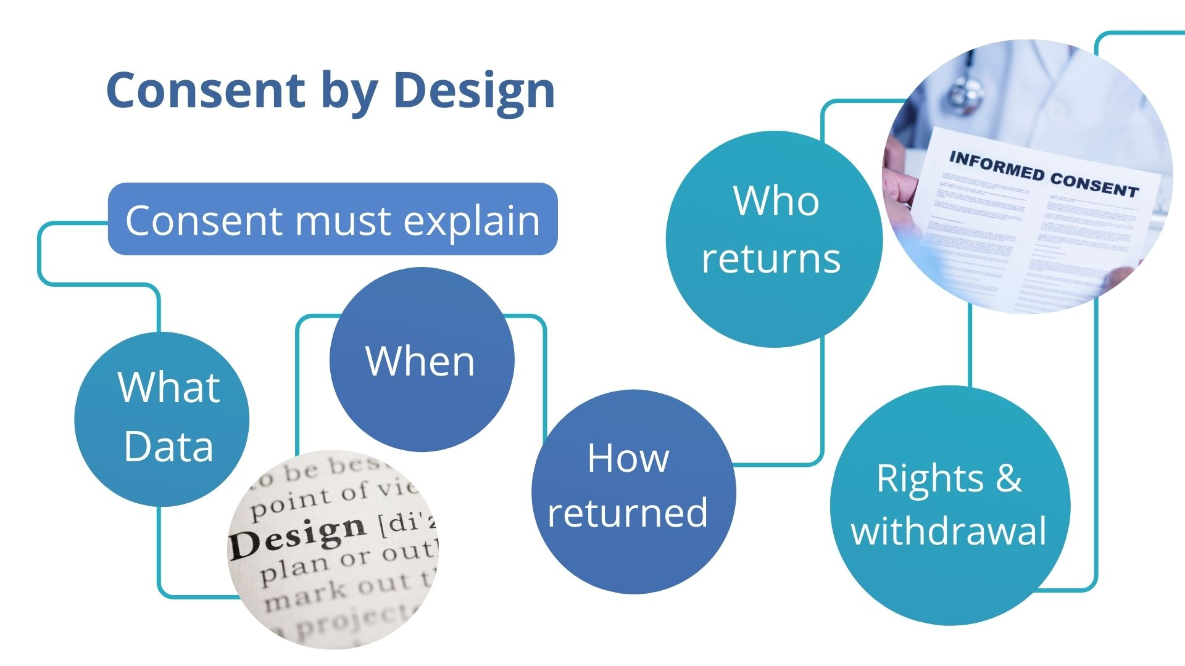
Notes:
The consent process will vary according to whether data is returned via a platform, via an individual, or a combination of a platform and a person.
Consent is a process and RoIPD can be discussed at 3 different junctures
Guidance we speak of the importance of health literacy. We encourage the development of basic health literacy tools, such as glossaries and links to relevant information, along with communication aids like images, audio, and video materials, to support the RoIPD process. These tools help address literacy gaps and communication challenges and we recommend the sharing of these tools to foster a community of practice in this area.
In our discussions on those involved in the return of data, we decided to focus on the skills of the individual who is engaging with the participant, rather than their profession. Thus, discussions on the RoIPD can be done by a research nurse or a healthcare professional and/or supported by communication experts such as cultural medicators and patient organisations. To guarantee the principles of beneficence and utility it is advisable to involve a health care professional in the process of clinical data return to facilitate the understanding of the data and eventual clinical implications.

Slide 8
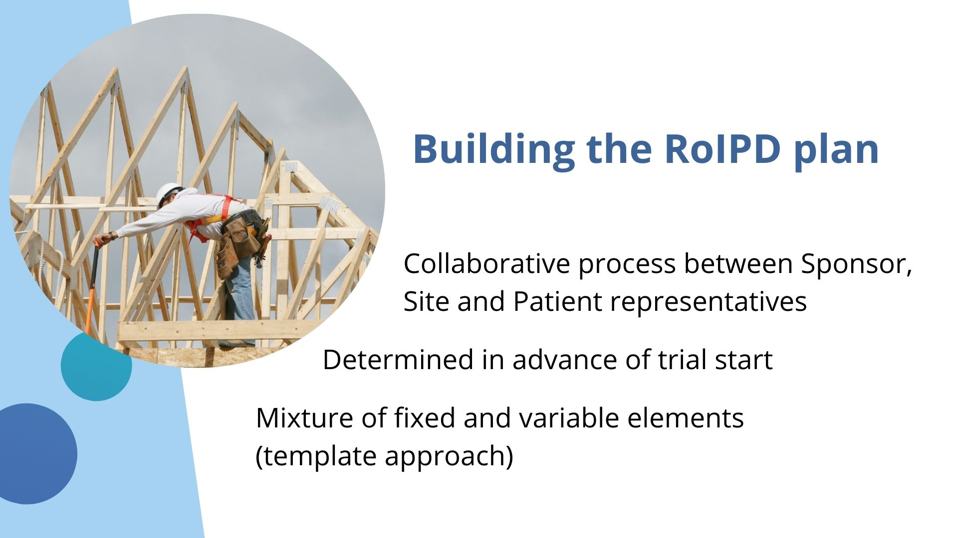
Notes:
A co-creation process for protocols on RoIPD is strongly encouraged that can involve investigators in the clinical trial and patient groups. Co-creation improves transparency, confers agency to the participant, and helps ensure that the concerns, safety and needs of the participants are considered while not compromising the integrity of the trial results and subsequent outcomes for patients.
A RoIPD plan does not need to be co-created for every trial. RoIPD plans can be co-created for different types of clinical trials. These RoIPD are encouraged to be shared. As RoIPD will be part of the clinical trial protocol, it will require approval by a REC. Furthermore, any modifications to the RoIPD process need REC endorsement, as required by ICH GCP.
In developing RoIPD protocols, discussions within FACILITAE have considered the following to be important to be discussed…
Consent process: The process for providing participants with information and obtaining their consent should be included in the protocol
The protocol should clearly articulate the roles of all parties involved, including sponsors, investigators, participant representatives. ethics committees, data managers. This clarity will help ensure that each stakeholder understands their duties and the expectations placed upon them. For example, the Sponsor is ultimately responsible for ensuring that there is a RoIPD plan in place and that this plan is operationalised at each site.
Participants should be informed about what data will be returned during the clinical trial and at what point during the clinical trial they should expect this return. It is encouraged that there is ongoing communication during the trial with participants on when data can be made available, and this should be communicated to participants. If certain data can only be returned after the clinical trial, participants will need to be informed why this can only be made available after the trial.
The protocol should define the data to be returned and data that will not be returned. The data to be returned is a topic of ongoing debate within FACILITATE and we expect to issue guidance on this point in 2026
Align all procedures with existing ethical guidelines and legal requirements, GDPR, national ethical and legal requirements and ICH GCP. This alignment should focus on protecting participant privacy and ensuring data security, quality and integrity.

Slide 9
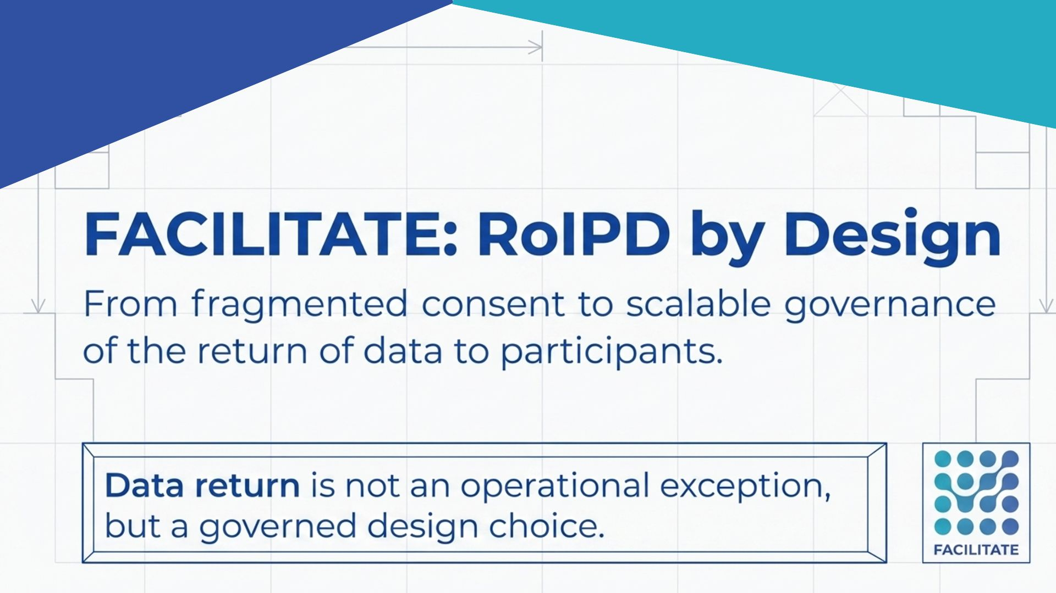


Slide 10
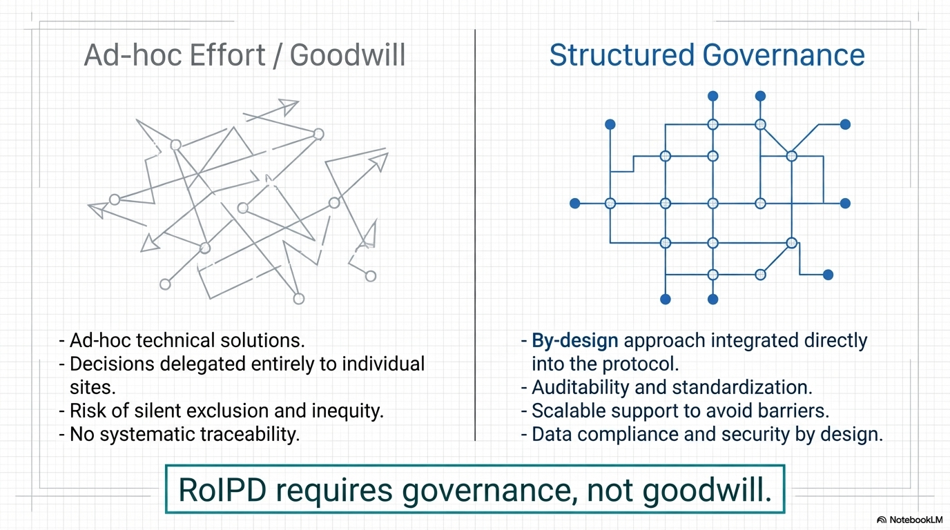

Slide 11
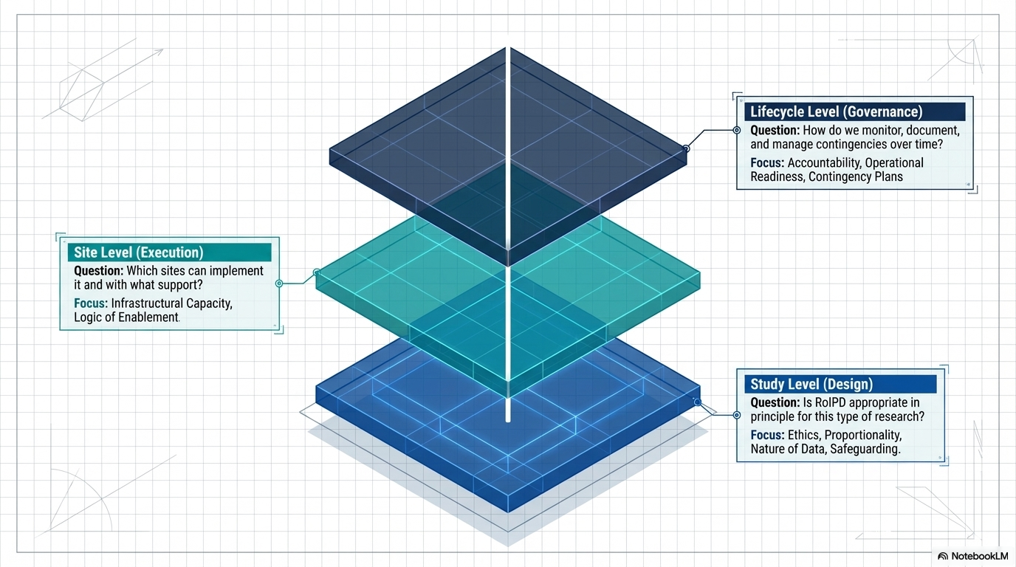
The core principle: Separation of decision layers

Slide 12
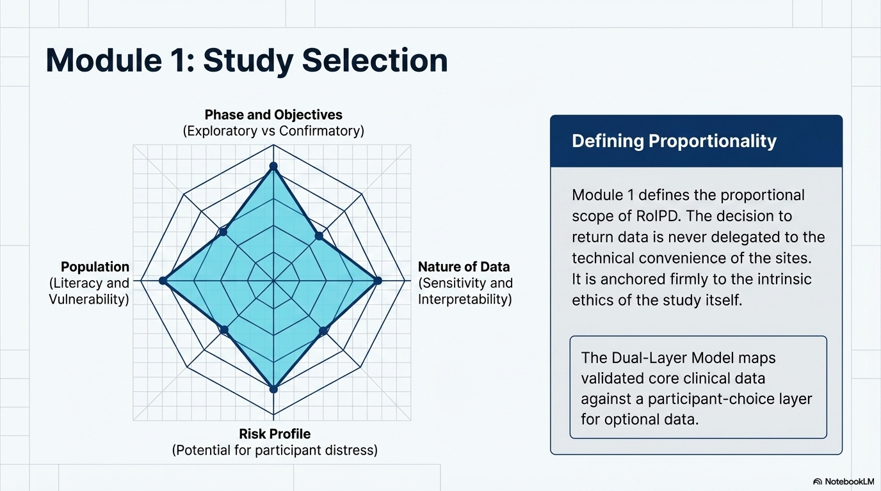

Slide 13
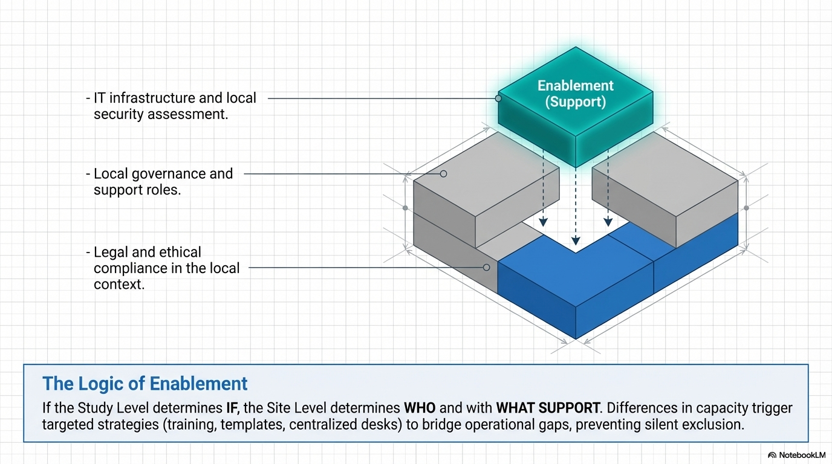
Module 2: Site selection and the logic of enablement

Slide 14
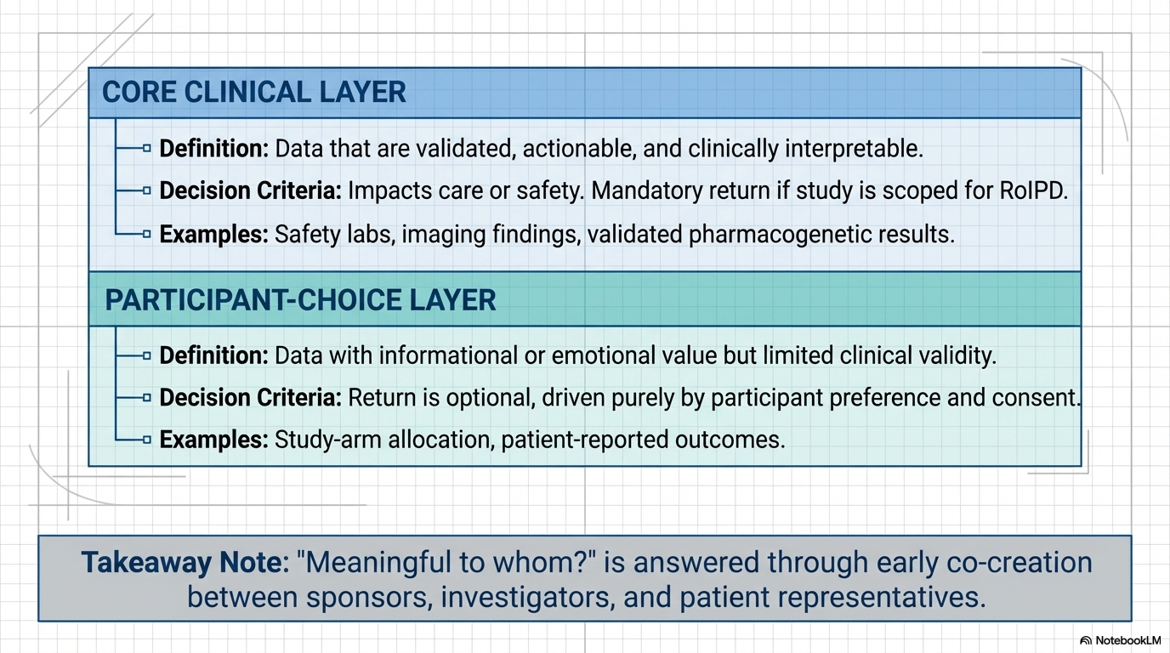

Slide 15
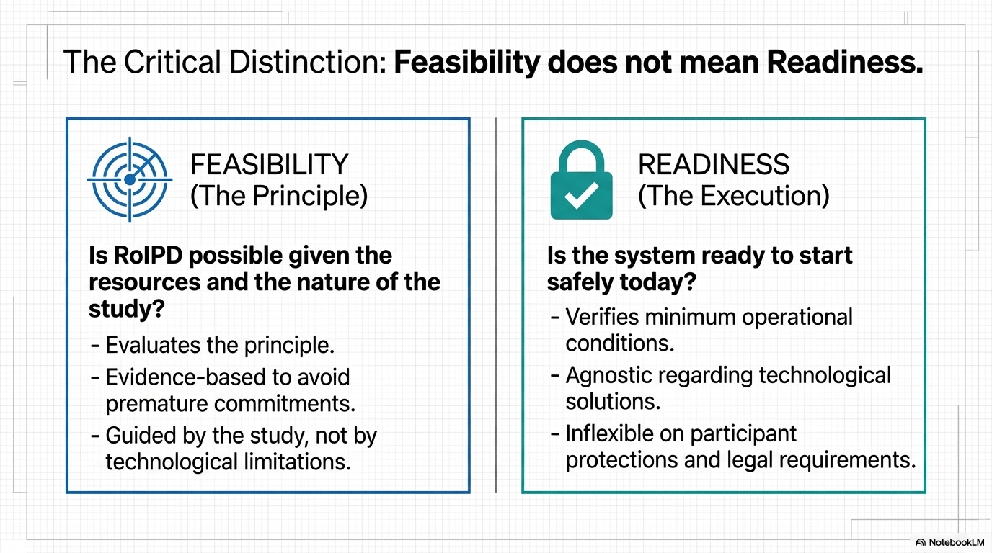

Slide 16
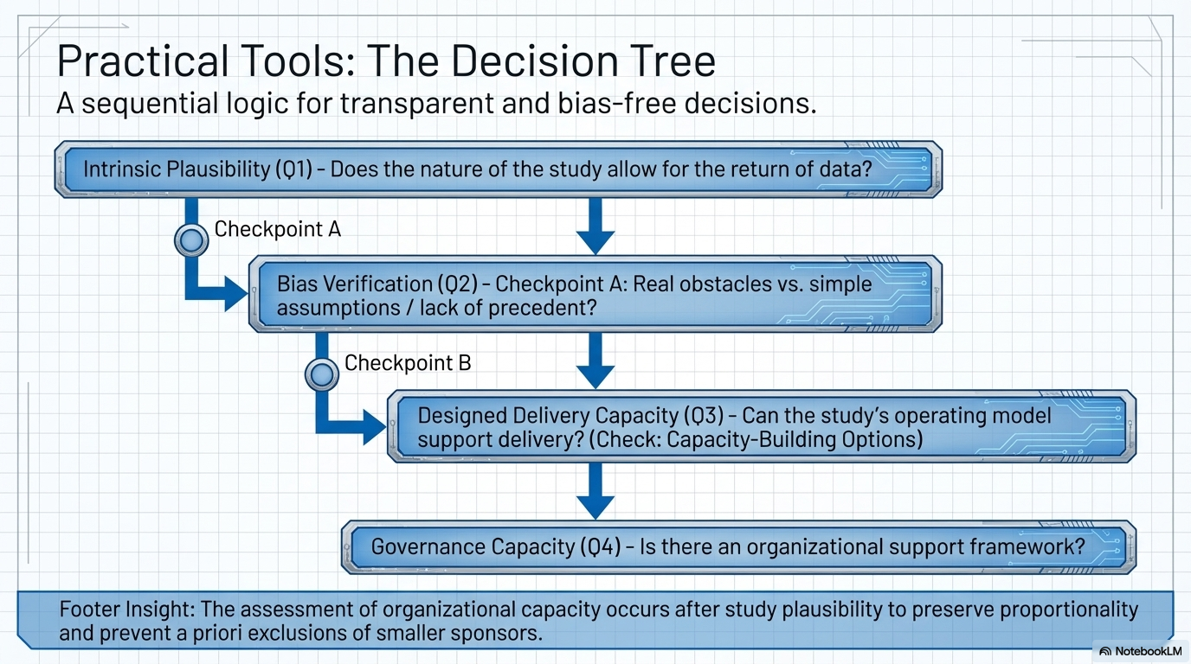

Slide 17
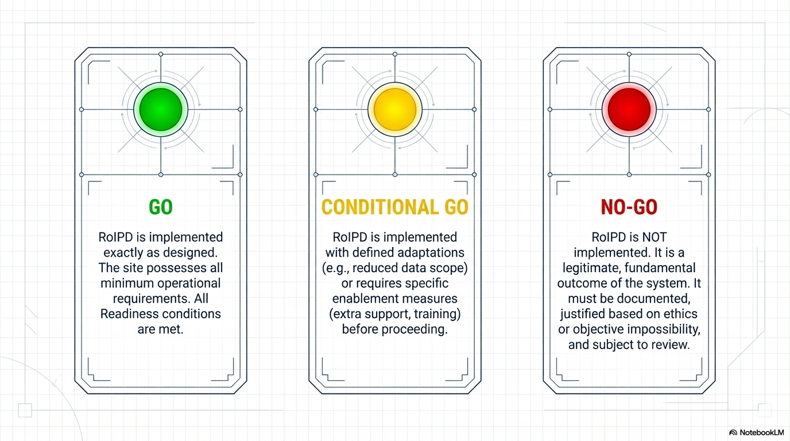
The Decision Gates Architecture:
Formalizing accountability at the end of the readiness assessment

Slide 18
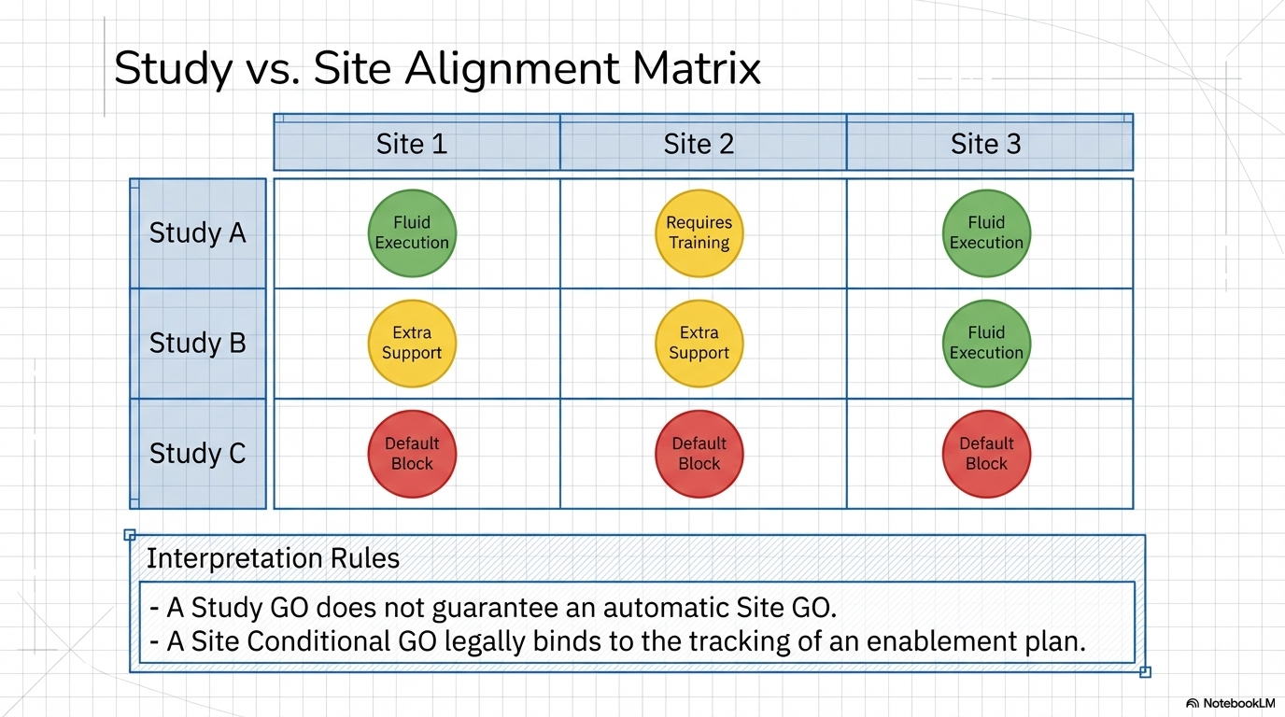

Slide 19
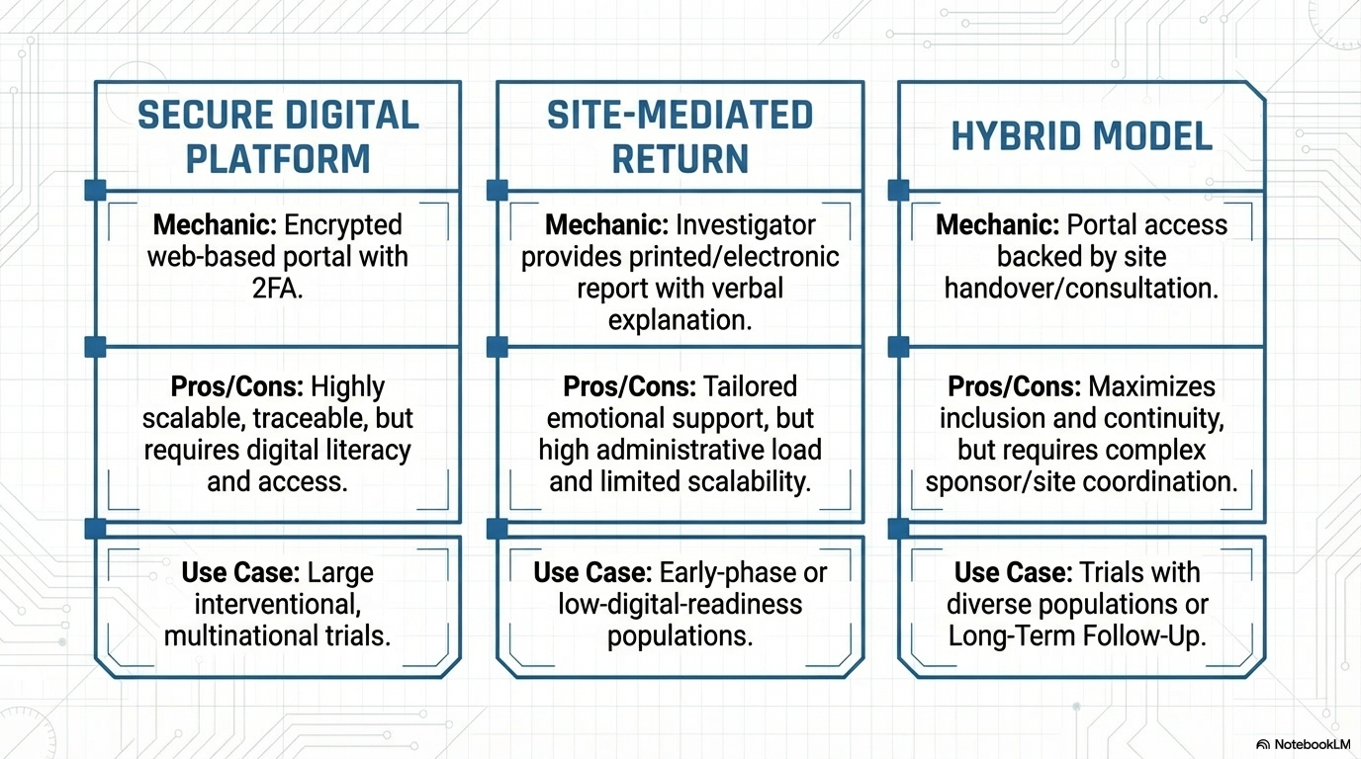

Slide 20
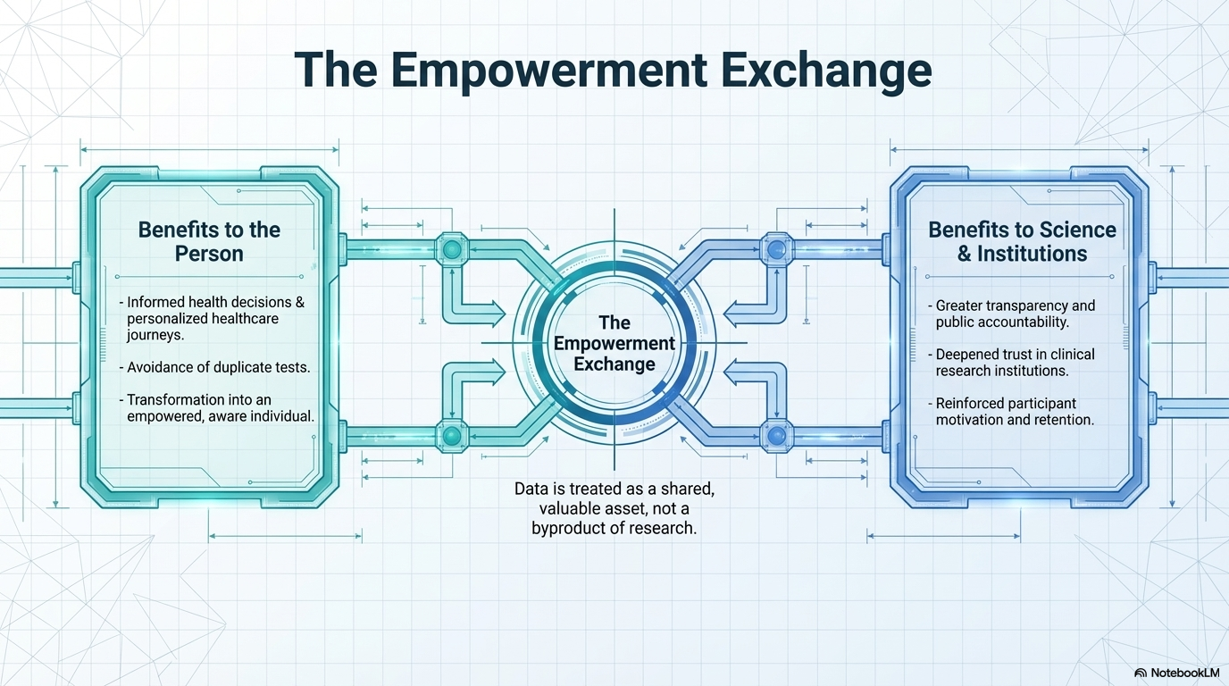


Slide 21
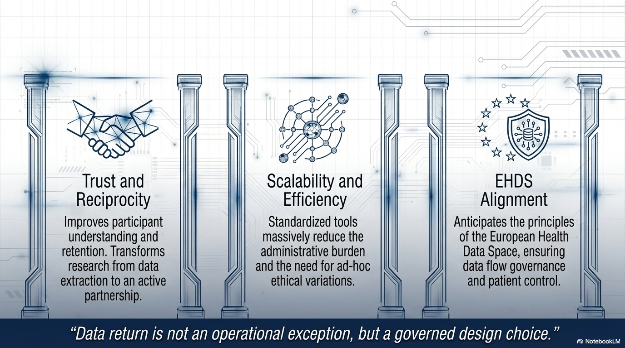

Slide 22
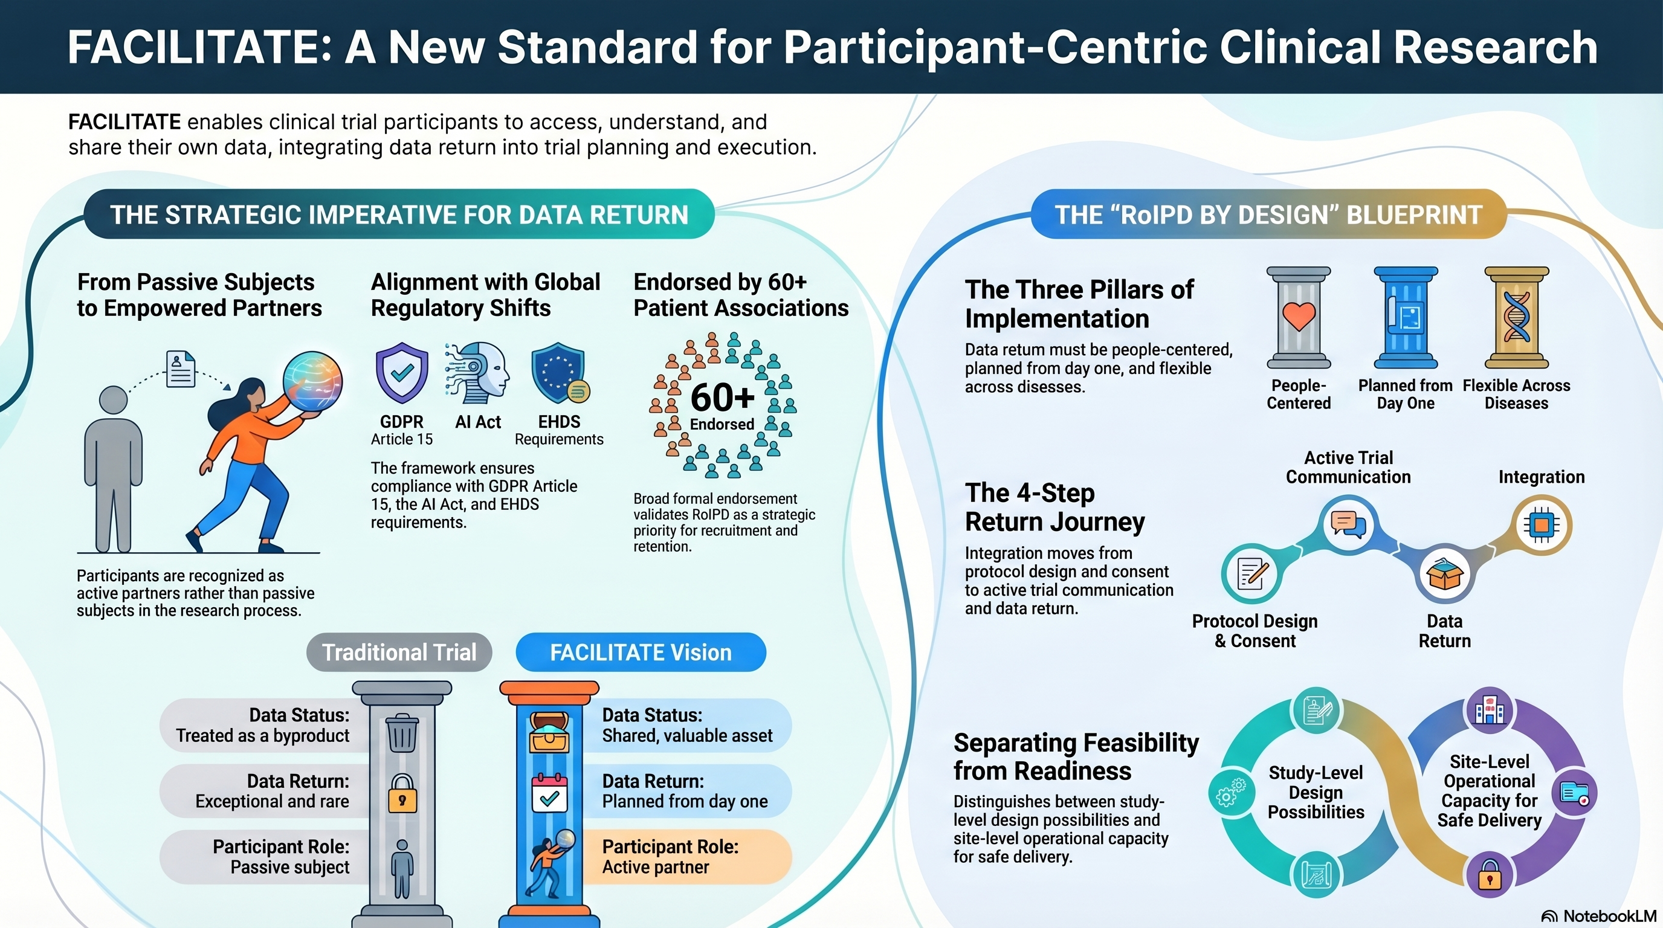

Slide 23


Slide 24
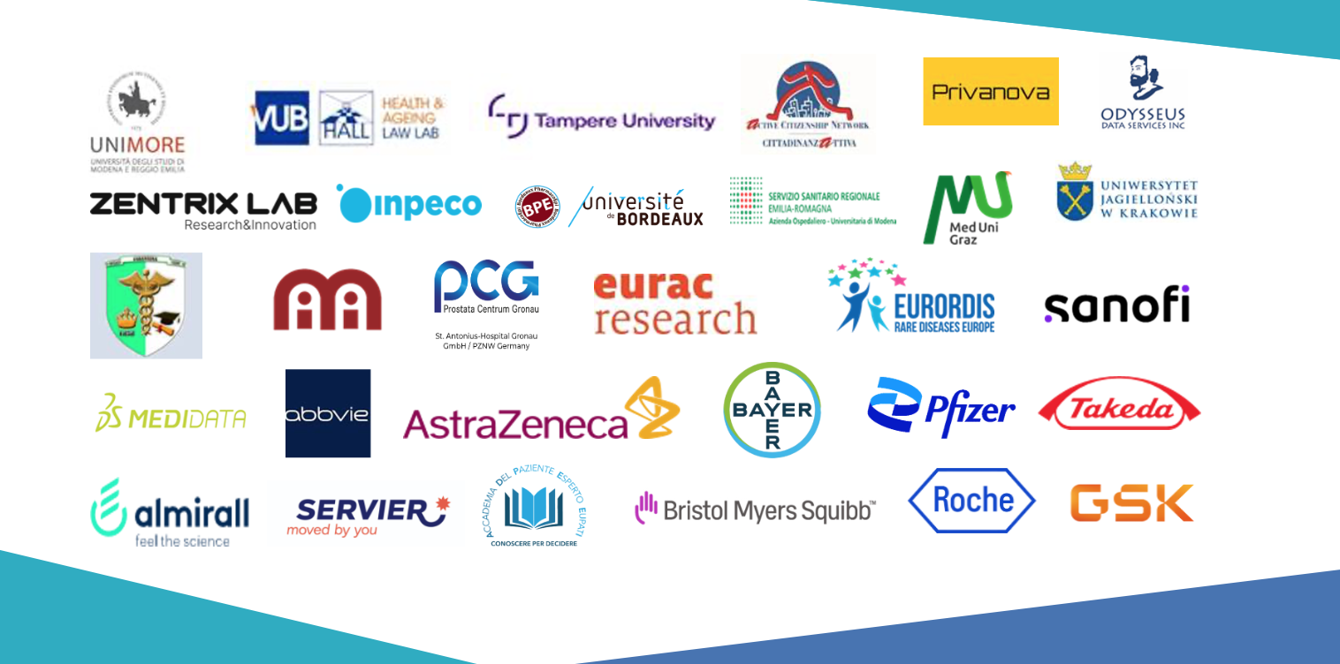


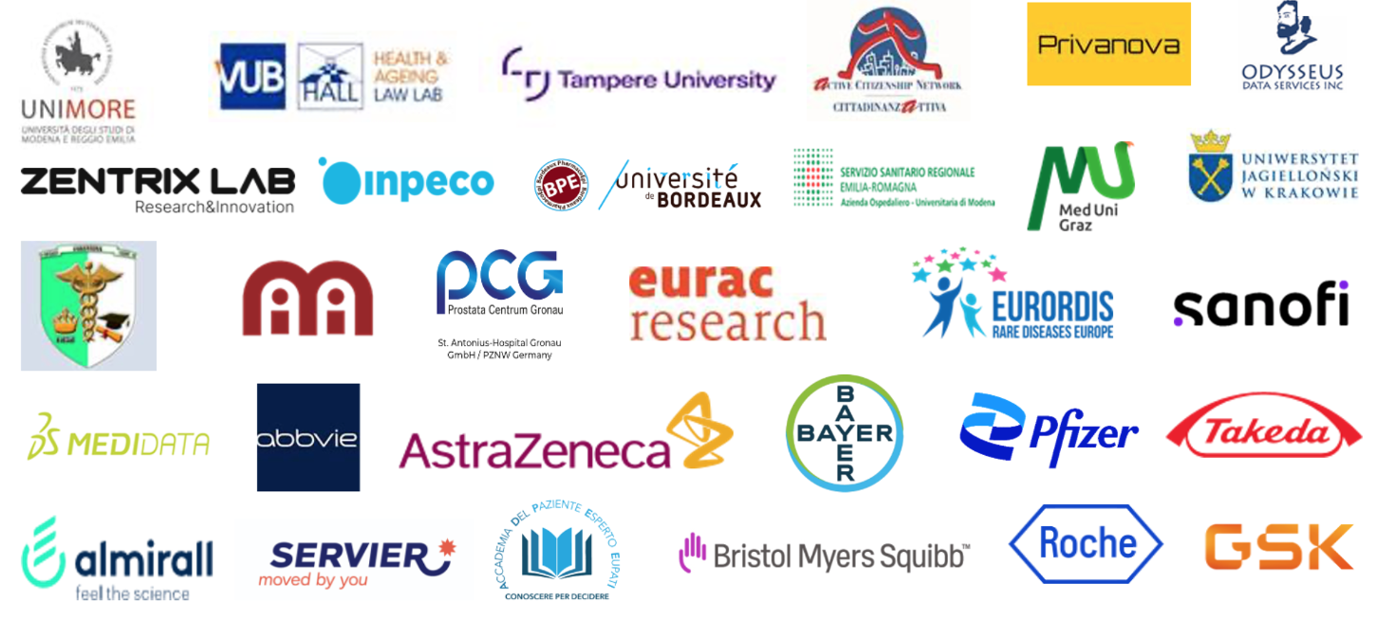

Thank you for your attention
This project has received funding from the Innovative Medicines Initiative 2 Joint Undertaking (JU) under grant agreement No 101034366. The JU receives support from the European Union’s Horizon 2020 research and innovation program and EFPIA.

